Slide 1
Chapter 7: IP Addressing
Introduction to Networks
Notes:
Cisco Networking Academy program
Network Basics
Chapter 7: IP Addressing

Slide 2
Chapter 7
7.0 Introduction
7.1 IPv4 Network Addresses
7.2 IPv6 Network Addresses
7.3 Summary
Notes:
Chapter 7 Sections

Slide 3
IP Addressing Chapter 7: Objectives
In this chapter, you will be able to:
Describe the structure of an IPv4 address.
Describe the purpose of the subnet mask.
Compare the characteristics and uses of the unicast, broadcast and multicast IPv4 addresses.
Explain the need for IPv6 addressing.
Describe the representation of an IPv6 address.
Describe types of IPv6 network addresses.
Configure global unicast addresses.

Slide 4
IP Addressing Introduction
In this chapter, you will be able to (continued):
Describe multicast addresses.
Describe the role of ICMP in an IP network (include IPv4 and IPv6)
Use ping and traceroute utilities to test network connectivity

Slide 5
8.1 IPv4 Network Addresses
Notes:
Section 8.1.1

Slide 6
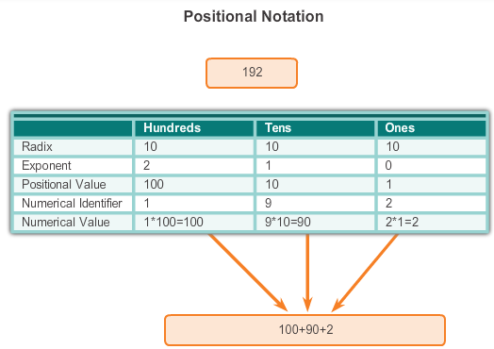
IPv4 Address Structure Binary Notation
Binary notation refers to the fact that computers communicate in 1s and 0s
Converting binary to decimal requires an understanding of the mathematical basis of a numbering system – positional notation
Notes:
Section 8.1.1.1

Slide 7

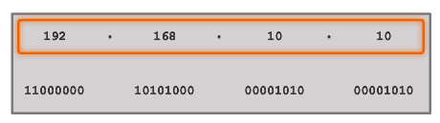


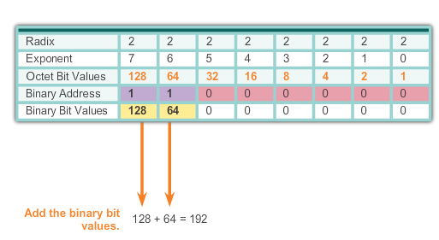
IPv4 Address Structure Binary Number System
Notes:
Section 8.1.1.2

Slide 8


IPv4 Address Structure Converting a Binary Address to Decimal
Practice
Notes:
Section 8.1.1.3 & 8.1.1.4

Slide 9
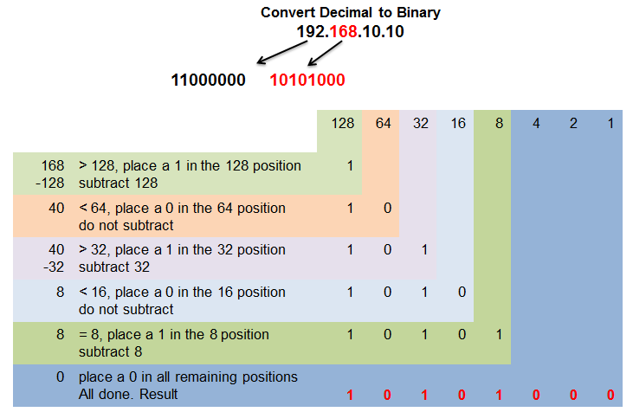
IPv4 Address Structure Converting from Decimal to Binary
Notes:
Section 8.1.1.5

Slide 10
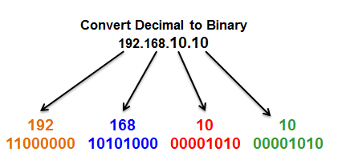
IPv4 Address Structure Converting from Decimal to Binary Conversions
Notes:
Section 8.1.1.6

Slide 11
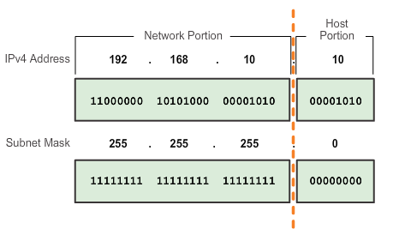
IPv4 Subnet Mask Network Portion and Host Portion of an IPv4 Address
To define the network and host portions of an address, a devices use a separate 32-bit pattern called a subnet mask
The subnet mask does not actually contain the network or host portion of an IPv4 address, it just says where to look for these portions in a given IPv4 address
Notes:
Section 8.1.2.1

Slide 12
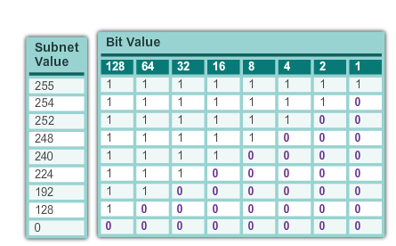
IPv4 Subnet Mask Network Portion and Host Portion of an IPv4 Address
Valid Subnet Masks
Notes:
Section 8.1.2.1

Slide 13
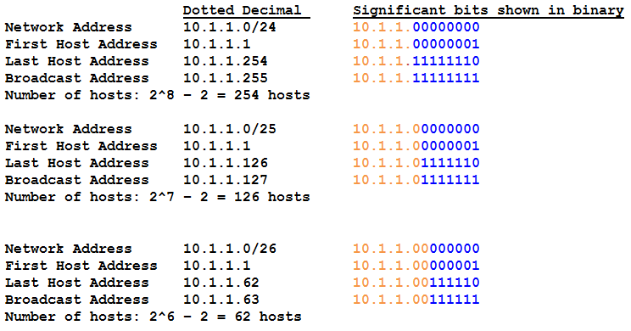
IPv4 Subnet Mask Examining the Prefix Length
Notes:
Section 8.1.2.2

Slide 14
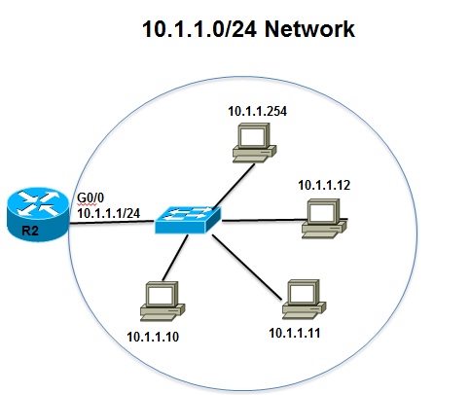
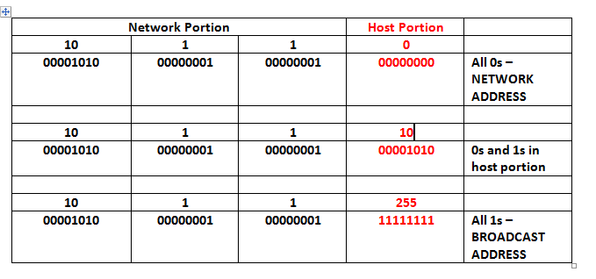
IPv4 Subnet Mask IPv4 Network, Host, and Broadcast Address
Notes:
Section 8.1.2.3

Slide 15
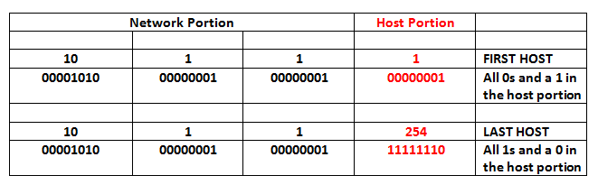
IPv4 Subnet Mask First Host and Last Host Addresses
Notes:
Section 8.1.2.4

Slide 16
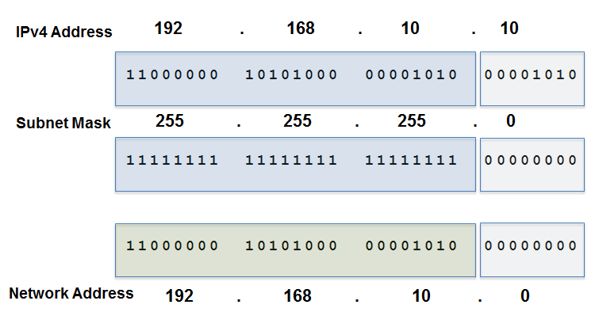
IPv4 Subnet Mask Bitwise AND Operation
1 AND 1 = 1 1 AND 0 = 0 0 AND 1 = 0 0 AND 0 = 0
Notes:
Section 8.1.2.5 and 8.1.2.6

Slide 17
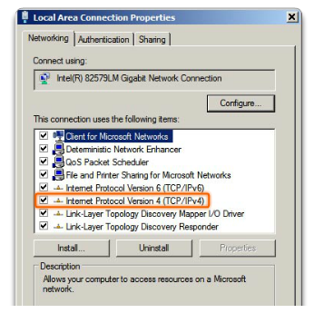
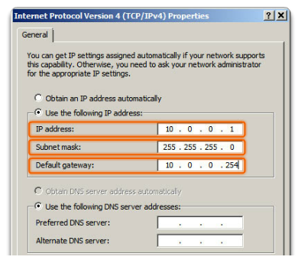
IPv4 Unicast, Broadcast, and Multicast Assigning a Static IPv4 Address to a Host
LAN Interface Properties
Configuring a Static IPv4 Address
Notes:
Section 8.1.3.1

Slide 18
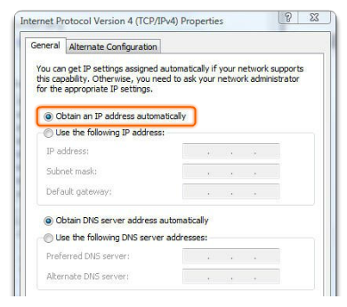
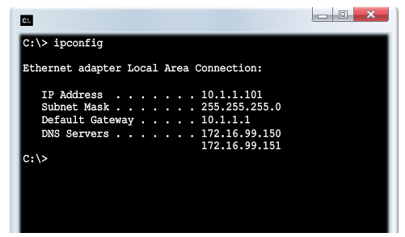
IPv4 Unicast, Broadcast, and Multicast Assigning a Dynamic IPv4 Address to a Host
Verification
DHCP - preferred method of “leasing” IPv4 addresses to hosts on large networks, reduces the burden on network support staff and virtually eliminates entry errors
Notes:
Section 8.1.3.2

Slide 19
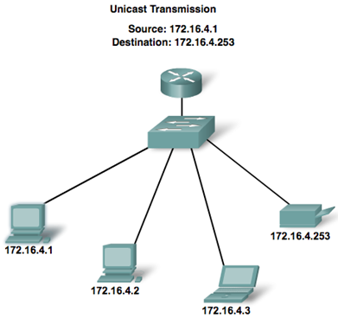
IPv4 Unicast, Broadcast, and Multicast Unicast Transmission
In an IPv4 network, the hosts can communicate one of three different ways:
Unicast - the process of sending a packet from one host to an individual host.
Notes:
Section 8.1.3.3

Slide 20
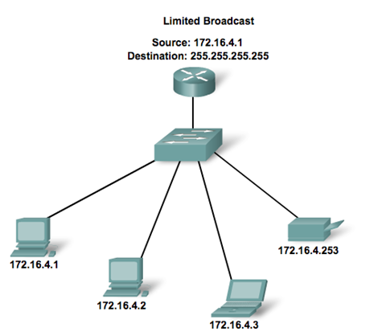
IPv4 Unicast, Broadcast, and Multicast Broadcast Transmission
Broadcast - the process of sending a packet from one host to all hosts in the network
Routers do not forward a limited broadcast!
Directed broadcast
Destination 172.16.4.255
Hosts within the 172.16.4.0/24 network
Notes:
Section 8.1.3.4

Slide 21
IPv4 Unicast, Broadcast, and Multicast Multicast Transmission
Multicast - the process of sending a packet from one host to a selected group of hosts, possibly in different networks
Reduces traffic
Reserved for addressing multicast groups - 224.0.0.0 to 239.255.255.255.
Link local - 224.0.0.0 to 224.0.0.255 (Example: routing information exchanged by routing protocols)
Globally scoped addresses - 224.0.1.0 to 238.255.255.255 (Example: 224.0.1.1 has been reserved for Network Time Protocol)
Notes:
Section 8.1.3.5

Slide 22
Types of IPv4 Address Public and Private IPv4 Addresses
Private address blocks are:
Hosts that do not require access to the Internet can use private addresses
10.0.0.0 to 10.255.255.255 (10.0.0.0/8)
172.16.0.0 to 172.31.255.255 (172.16.0.0/12)
192.168.0.0 to 192.168.255.255 (192.168.0.0/16)
Shared address space addresses:
Not globally routable
Intended only for use in service provider networks
Address block is 100.64.0.0/10
Notes:
Section 8.1.4.1

Slide 23
Types of IPv4 Address Special Use IPv4 Addresses
Network and Broadcast addresses - within each network the first and last addresses cannot be assigned to hosts
Loopback address - 127.0.0.1 a special address that hosts use to direct traffic to themselves (addresses 127.0.0.0 to 127.255.255.255 are reserved)
Link-Local address - 169.254.0.0 to 169.254.255.255 (169.254.0.0/16) addresses can be automatically assigned to the local host
TEST-NET addresses - 192.0.2.0 to 192.0.2.255 (192.0.2.0/24) set aside for teaching and learning purposes, used in documentation and network examples
Experimental addresses - 240.0.0.0 to 255.255.255.254 are listed as reserved
Notes:
Section 8.1.4.3

Slide 24
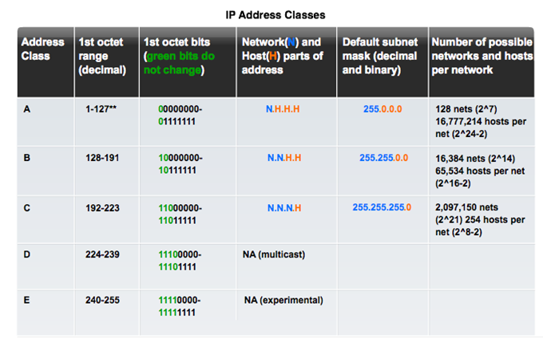
Types of IPv4 Address Legacy Classful Addressing
Notes:
Section 8.1.4.4

Slide 25
Types of IPv4 Address Legacy Classful Addressing
Classless Addressing
Formal name is Classless Inter-Domain Routing (CIDR, pronounced “cider
Created a new set of standards that allowed service providers to allocate IPv4 addresses on any address bit boundary (prefix length) instead of only by a class A, B, or C address
Notes:
Section 8.1.4.4

Slide 26
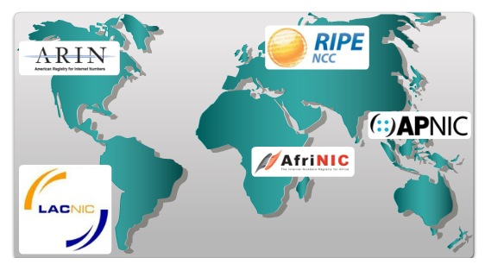
Types of IPv4 Address Assignment of IP Addresses
Regional Internet Registries (RIRs)
The major registries are:
Notes:
Section 8.1.4.5

Slide 27
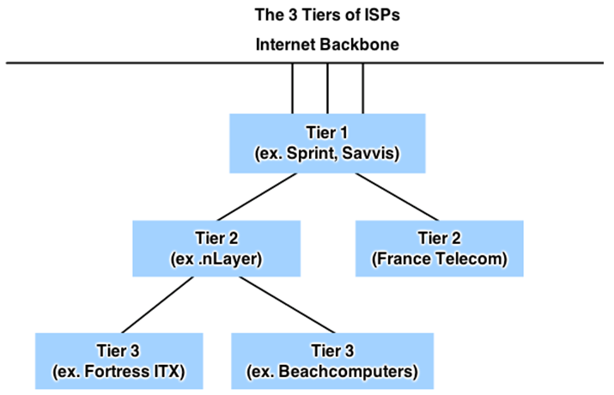
Types of IPv4 Address Assignment of IP Addresses
ISPs are large national or international ISPs that are directly connected to the Internet backbone.
Tier 2 ISPs generally focus on business customers.
Tier 3 ISPs often bundle Internet connectivity as a part of network and computer service contracts for their customers.
Tier 3 ISPs purchase their Internet service from Tier 2 ISPs.
Notes:
Section 8.1.4.6

Slide 28
Continue Workbook 1.5

Slide 29
IPv4 Issues The Need for IPv6
IPv6 is designed to be the successor to IPv4
Depletion of IPv4 address space has been the motivating factor for moving to IPv6
Projections show that all five RIRs will run out of IPv4 addresses between 2015 and 2020
With an increasing Internet population, a limited IPv4 address space, issues with NAT and an Internet of things, the time has come to begin the transition to IPv6!
Notes:
Section 8.2.1.1

Slide 30
IPv4 Issues The Need for IPv6
IPv4 has theoretical maximum of 4.3 billion addresses plus private addresses in combination with NAT
IPv6 larger 128-bit address space providing for 340 undecillion addresses
IPv6 fixes the limitations of IPv4 and include additional enhancements such as ICMPv6
Notes:
Section 8.2.1.1

Slide 31
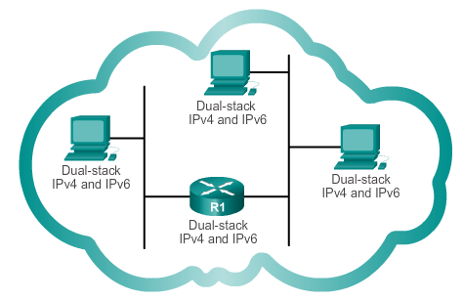
IPv4 Issues IPv4 and IPv6 Coexistence
The migration techniques can be divided into three categories:
#1
Dual-stack: Allows IPv4 and IPv6 to coexist on the same network. Devices run both IPv4 and IPv6 protocol stacks simultaneously.
Notes:
Section 8.2.1.2

Slide 32
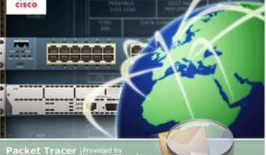
PT 8.3.4.5 (Dual Stack implementation)

Slide 33
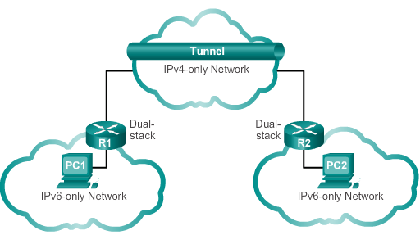
IPv4 Issues IPv4 and IPv6 Coexistence
The migration techniques can be divided into three categories:
#2
Tunnelling: A method of transporting an IPv6 packet over an IPv4 network. The IPv6 packet is encapsulated inside an IPv4 packet.
Notes:
Section 8.2.1.2

Slide 34
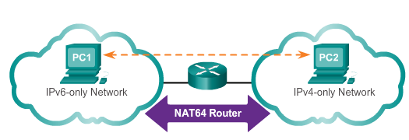
IPv4 Issues IPv4 and IPv6 Coexistence
The migration techniques can be divided into three categories:
#3
Translation: Network Address Translation 64 (NAT64) allows IPv6-enabled devices to communicate with IPv4-enabled devices using a translation technique similar to NAT for IPv4. An IPv6 packet is translated to an IPv4 packet, and vice versa.
Notes:
Section 8.2.1.2

Slide 35
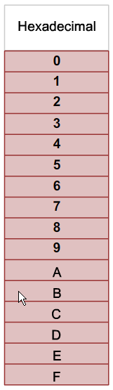
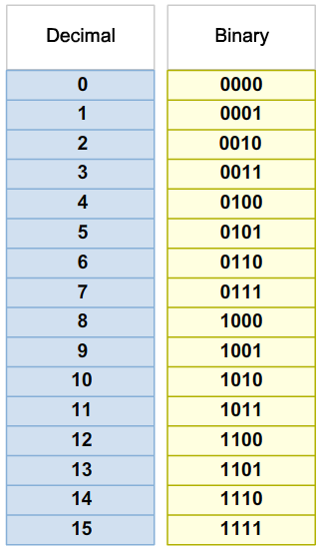
IPv6 Addressing Hexadecimal Number System
Hexadecimal is a base sixteen system
Base 16 numbering system uses the numbers 0 to 9 and the letters A to F
Four bits (half of a byte) can be represented with a single hexadecimal value
Notes:
Section 8.2.2.1

Slide 36
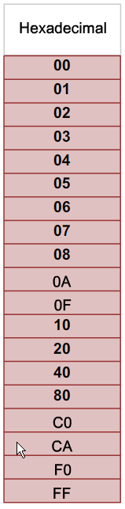
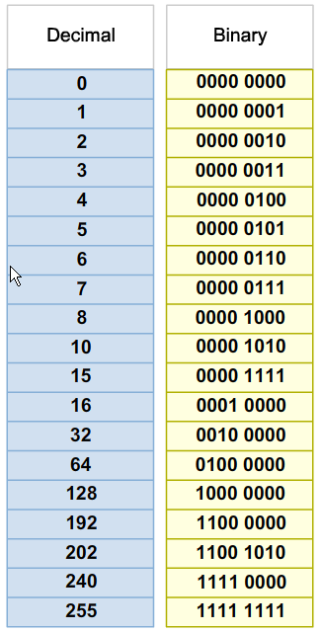
IPv6 Addressing IPv6 Address Representation
Look at the binary bit patterns that match the decimal and hexadecimal values
Notes:
Section 8.2.2.1

Slide 37
IPv6 Addressing IPv6 Address Representation
128 bits in length and written as a string of hexadecimal values
In IPv6, 4 bits represents a single hexadecimal digit, 32 hexadecimal values = IPv6 address
2001:0DB8:0000:1111:0000:0000:0000:0200
FE80:0000:0000:0000:0123:4567:89AB:CDEF
Hextet used to refer to a segment of 16 bits or four hexadecimals
Can be written in either lowercase or uppercase
Notes:
Section 8.2.2.2

Slide 38

IPv6 Addressing Rule 1- Omitting Leading 0s
The first rule to help reduce the notation of IPv6 addresses is any leading 0s (zeros) in any 16-bit section or hextet can be omitted
01AB can be represented as 1AB
09F0 can be represented as 9F0
0A00 can be represented as A00
00AB can be represented as AB
Notes:
Section 8.2.2.3

Slide 39
IPv6 Addressing Rule 2- Omitting All 0 Segments
A double colon (::) can replace any single, contiguous string of one or more 16-bit segments (hextets) consisting of all 0’s
Double colon (::) can only be used once within an address otherwise the address will be ambiguous
Known as the compressed format
Incorrect address - 2001:0DB8::ABCD::1234
Notes:
Section 8.2.2.4

Slide 40
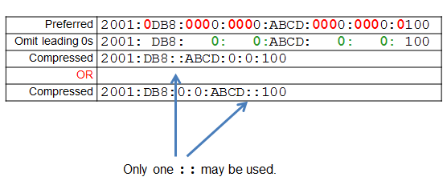
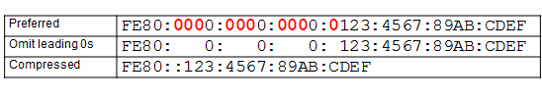
IPv6 Addressing Rule 2- Omitting All 0 Segments
Examples
#1
#2
Notes:
Section 8.2.2.4

Slide 41
Types of IPv6 Addresses IPv6 Address Types
There are three types of IPv6 addresses:
Unicast
Multicast
Anycast.
Note: IPv6 does not have broadcast addresses.
Notes:
Section 8.2.3.1

Slide 42
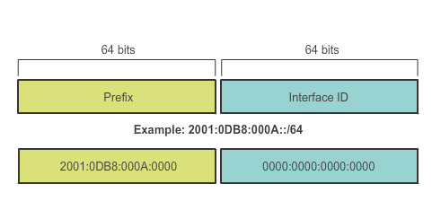
Types of IPv6 Addresses IPv6 Prefix Length
IPv6 does not use the dotted-decimal subnet mask notation
Prefix length indicates the network portion of an IPv6 address using the following format:
IPv6 address/prefix length
Prefix length can range from 0 to 128
Typical prefix length is /64
Notes:
Section 8.2.3.2

Slide 43
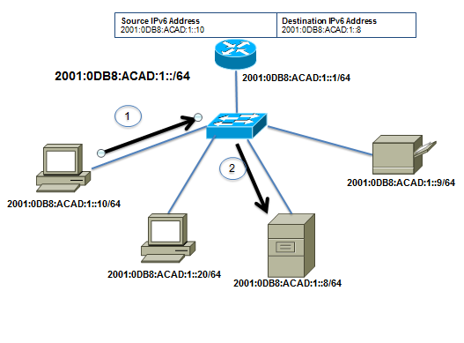
Types of IPv6 Addresses IPv6 Unicast Addresses
Unicast
Uniquely identifies an interface on an IPv6-enabled device
A packet sent to a unicast address is received by the interface that is assigned that address.
Source IPv6 MUST be unicast address. The destination IPv6 address cab be either a unicast or a multicast address.
Notes:
Section 8.2.3.1/8.2.3.3

Slide 44
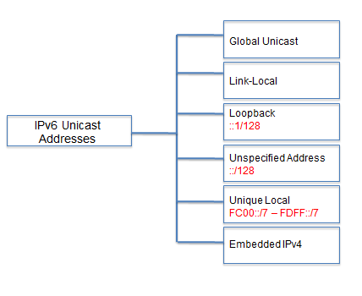
Types of IPv6 Addresses IPv6 Unicast Addresses
Notes:
Section 8.2.3.3

Slide 45
Types of IPv6 Addresses IPv6 Unicast Addresses
Global unicast
Similar to a public IPv4 address
Globally unique
Internet routable addresses.
Can be configured statically or assigned dynamically
Link-local
Used to communicate with other devices on the same local link
Confined to a single link - not routable beyond the link
The term Link in IPv6 refers to as a subnet
Notes:
Section 8.2.3.3

Slide 46
Types of IPv6 Addresses IPv6 Unicast Addresses
Loopback
Used by a host to send a packet to itself and cannot be assigned to a physical interface
Ping an IPv6 loopback address to test the configuration of TCP/IP on the local host
All-0s except for the last bit, represented as ::1/128 or just ::1
Unspecified address
All-0’s address represented as ::/128 or just ::
Cannot be assigned to an interface and is only used as a source address
An unspecified address is used as a source address when the device does not yet have a permanent IPv6 address or when the source of the packet is irrelevant to the destination
Notes:
Section 8.2.3.3

Slide 47
Types of IPv6 Addresses IPv6 Unicast Addresses
Unique local
Similar to private addresses for IPv4
Used for local addressing within a site or between a limited number of sites
In the range of FC00::/7 to FDFF::/7
IPv4 embedded (not covered in this course)
Used to help transition from IPv4 to IPv6
Notes:
Section 8.2.3.3

Slide 48
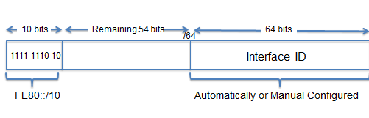
Types of IPv6 Addresses IPv6 Link-Local Unicast Addresses
Every IPv6-enabled network interface is REQUIRED to have a link-local address
Enables a device to communicate with other IPv6-enabled devices on the same link and only on that link (subnet)
FE80::/10 range, first 10 bits are 1111 1110 10xx xxxx
1111 1110 1000 0000 (FE80) - 1111 1110 1011 1111 (FEBF)
Notes:
Section 8.2.3.4

Slide 49
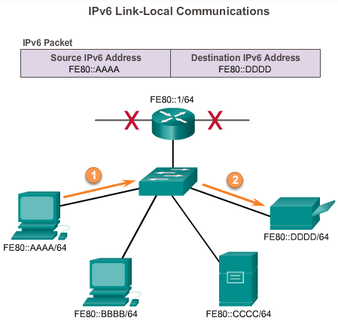
Types of IPv6 Addresses IPv6 Link-Local Unicast Addresses
Packets with a source or destination link-local address cannot be routed beyond the link from where the packet originated
Notes:
Section 8.2.3.4

Slide 50
IPv6 Unicast Addresses Structure of an IPv6 Global Unicast Address
IPv6 global unicast addresses are globally unique and routable on the IPv6 Internet
Equivalent to public IPv4 addresses
ICANN allocates IPv6 address blocks to the five RIRs
Currently, only global unicast addresses with the first three bits of 001 or 2000::/3 are being assigned
Notes:
Section 8.2.4.1

Slide 51
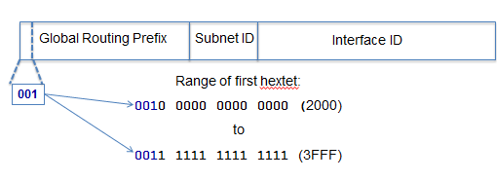
IPv6 Unicast Addresses Structure of an IPv6 Global Unicast Address
Currently, only global unicast addresses with the first three bits of 001 or 2000::/3 are being assigned
Notes:
Section 8.2.4.1

Slide 52
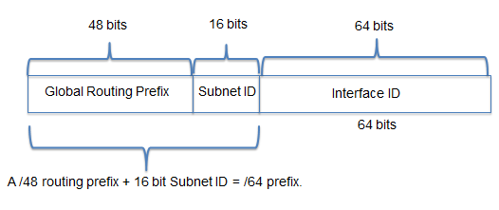
IPv6 Unicast Addresses Structure of an IPv6 Global Unicast Address
A global unicast address has three parts:
Global Routing Prefix- prefix or network portion of the address assigned by the provider, such as an ISP, to a customer or site, currently, RIR’s assign a /48 global routing prefix to customers
2001:0DB8:ACAD::/48 has a prefix that indicates that the first 48 bits (2001:0DB8:ACAD) is the prefix or network portion
Notes:
Section 8.2.4.1

Slide 53
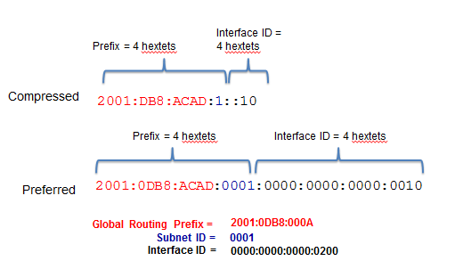
IPv6 Unicast Addresses Structure of an IPv6 Global Unicast Address
Subnet ID
Used by an organization to identify subnets within its site
Interface ID
Equivalent to the host portion of an IPv4 address
Used because a single host may have multiple interfaces, each having one or more IPv6 addresses
Notes:
Section 8.2.4.1

Slide 54
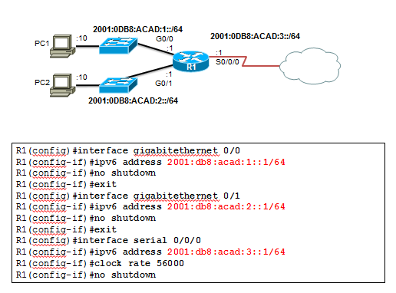
IPv6 Unicast Addresses Static Configuration of a Global Unicast Address
Notes:
Section 8.2.4.2

Slide 55
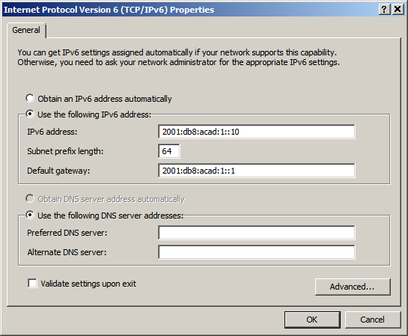
IPv6 Unicast Addresses Static Configuration of an IPv6 Global Unicast Address
Notes:
Section 8.2.4.2

Slide 56
IPv6 Unicast Addresses Dynamic Configuration of a Global Unicast Address using SLAAC
Stateless Address Autoconfiguraton (SLAAC)
A method that allows a device to obtain its prefix, prefix length and default gateway from an IPv6 router
No DHCPv6 server needed
Rely on ICMPv6 Router Advertisement (RA) messages
IPv6 routers
Forwards IPv6 packets between networks
Can be configured with static routes or a dynamic IPv6 routing protocol
Sends ICMPv6 RA messages
Notes:
Section 8.2.4.3

Slide 57
IPv6 Unicast Addresses Dynamic Configuration of a Global Unicast Address using SLAAC
Command IPv6 unicast routing enables IPv6 routing
RA message can contain one of the following three options
SLAAC Only – use the information contained in the RA message
SLAAC and DHCPv6 – use the information contained in the RA message and get other information from the DHCPv6 server, stateless DHCPv6 (example: DNS)
DHCPv6 only – device should not use the information in the RA, stateful DHCPv6
Routers send ICMPv6 RA messages using the link-local address as the source IPv6 address
Notes:
Section 8.2.4.3

Slide 58
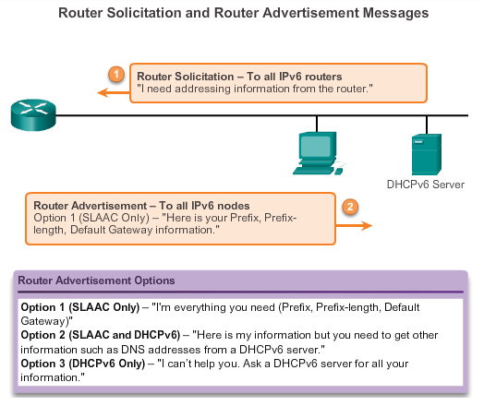
IPv6 Unicast Addresses Dynamic Configuration of a Global Unicast Address using SLAAC
Notes:
Section 8.2.4.3

Slide 59
IPv6 Unicast Addresses Dynamic Configuration of a Global Unicast Address using DHCPv6
Dynamic Host Configuration Protocol for IPv6 (DHCPv6)
Similar to IPv4
Automatically receive addressing information including a global unicast address, prefix length, default gateway address and the addresses of DNS servers using the services of a DHCPv6 server
Device may receive all or some of its IPv6 addressing information from a DHCPv6 server depending upon whether option 2 (SLAAC and DHCPv6) or option 3 (DHCPv6 only) is specified in the ICMPv6 RA message
Host may choose to ignore whatever is in the router’s RA message and obtain its IPv6 address and other information directly from a DHCPv6 server.
Notes:
Section 8.2.4.4

Slide 60
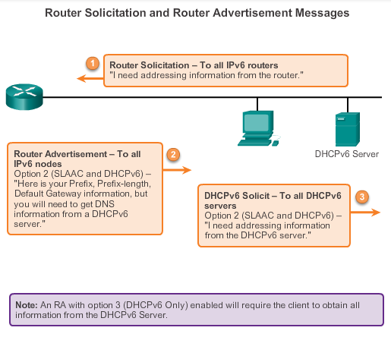
IPv6 Unicast Addresses Dynamic Configuration of a Global Unicast Address using DHCPv6
Notes:
Section 8.2.4.4

Slide 61
IPv6 Unicast Addresses EUI-64 Process or Randomly Generated
EUI-64 Process
process uses a client’s 48-bit Ethernet MAC address, and inserts another 16 bits in the middle of the 46-bit MAC address to create a 64-bit Interface ID
advantage is Ethernet MAC address can be used to determine the Interface – easily tracked
EUI-64 Interface ID is represented in binary and is made up of three parts:
24-bit OUI from the client MAC address, but the 7th bit (the Universally/Locally bit) is reversed (0 becomes a 1)
inserted 16-bit value FFFE
24-bit device identifier from the client MAC address
Notes:
Section 8.2.4.5

Slide 62
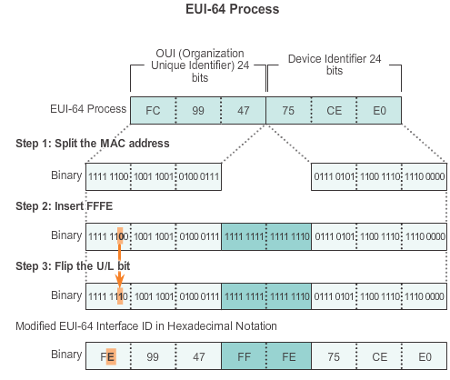
IPv6 Unicast Addresses EUI-64 Process or Randomly Generated
Notes:
Section 8.2.4.5

Slide 63
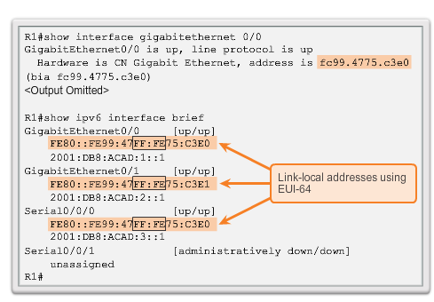
IPv6 Unicast Addresses EUI-64 Process or Randomly Generated
Notes:
Section 8.2.4.5

Slide 64
IPv6 Unicast Addresses EUI-64 Process or Randomly Generated
Randomly Generated Interface IDs
Depending upon the operating system, a device may use a randomly generated Interface ID instead of using the MAC address and the EUI-64 process
Beginning with Windows Vista, Windows uses a randomly generated Interface ID instead of one created with EUI-64
Windows XP and previous Windows operating systems used EUI-64
Notes:
Section 8.2.4.5

Slide 65
IPv6 Unicast Addresses Dynamic Link-local Addresses
Link-local Address
After a global unicast address is assigned to an interface, IPv6-enabled device automatically generates its link-local address
Must have a link-local address which enables a device to communicate with other IPv6-enabled devices on the same subnet
Uses the link-local address of the local router for its default gateway IPv6 address
Routers exchange dynamic routing protocol messages using link-local addresses
Routers’ routing tables use the link-local address to identify the next-hop router when forwarding IPv6 packets
Notes:
Section 8.2.4.6

Slide 66
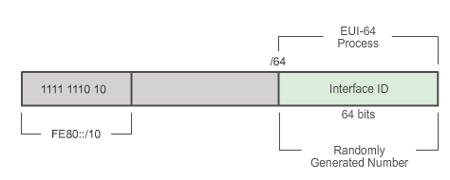
IPv6 Unicast Addresses Dynamic Link-local Addresses
Dynamically Assigned
Link-local address is dynamically created using the FE80::/10 prefix and the Interface ID
Notes:
Section 8.2.4.6

Slide 67
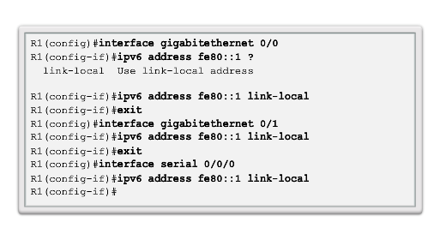
IPv6 Unicast Addresses Static Link-local Addresses
Configuring link-local
Notes:
Section 8.2.4.7

Slide 68
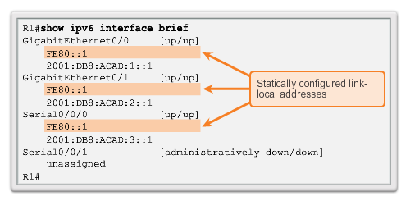
IPv6 Unicast Addresses Static Link-local Addresses
Configuring link-local
Notes:
Section 8.2.4.7

Slide 69
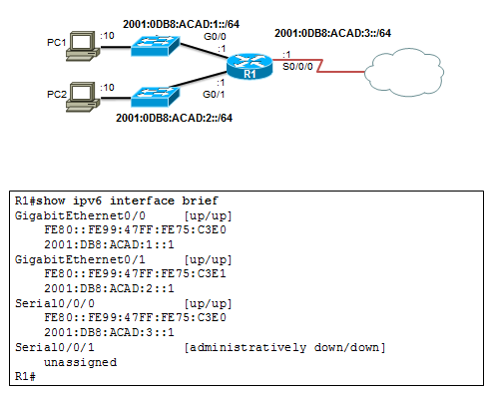
IPv6 Global Unicast Addresses Verifying IPv6 Address Configuration
Each interface has two IPv6 addresses -
global unicast address that was configured
one that begins with FE80 is automatically added link-local unicast address
Notes:
Section 8.2.4.8

Slide 70
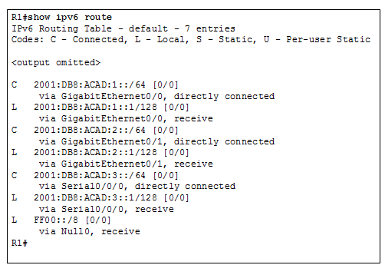
IPv6 Global Unicast Addresses Verifying IPv6 Address Configuration
Notes:
Section 8.2.4.8

Slide 71
IPv6 Multicast Addresses Assigned IPv6 Multicast Addresses
IPv6 multicast addresses have the prefix FFxx::/8
There are two types of IPv6 multicast addresses:
Assigned multicast
Solicited node multicast
Notes:
Section 8.2.5.1

Slide 72
IPv6 Multicast Addresses Assigned IPv6 Multicast Addresses
Two common IPv6 assigned multicast groups include:
FF02::1 All-nodes multicast group –
all IPv6-enabled devices join
same effect as an IPv4 broadcast address
FF02::2 All-routers multicast group –
all IPv6 routers join
a router becomes a member of this group when it is enabled as an IPv6 router with the ipv6 unicast-routing global configuration command
a packet sent to this group is received and processed by all IPv6 routers on the link or network.
Notes:
Section 8.2.5.1

Slide 73

IPv6 Multicast Addresses Assigned IPv6 Multicast Addresses
Notes:
Section 8.2.5.1

Slide 74

IPv6 Multicast Addresses Solicited Node IPv6 Multicast Addresses
Similar to the all-nodes multicast address, matches only the last 24 bits of the IPv6 global unicast address of a device
Automatically created when the global unicast or link-local unicast addresses are assigned
Created by combining a special FF02:0:0:0:0:FF00::/104 prefix with the right-most 24 bits of its unicast address.
Notes:
Section 8.2.5.2

Slide 75
IPv6 Multicast Addresses Solicited Node IPv6 Multicast Addresses
The solicited node multicast address consists of two parts:
FF02:0:0:0:0:FF00::/104 multicast prefix - first 104 bits of the all solicited node multicast address
Least significant 24-bits – copied from the right-most 24 bits of the global unicast or link-local unicast address of the device
Notes:
Section 8.2.5.2

Slide 76
ICMP ICMPv4 and ICMPv6 Messages
ICMP messages common to both ICMPv4 and ICMPv6 include:
Host confirmation
Destination or Service Unreachable
Time exceeded
Route redirection
Although IP is not a reliable protocol, the TCP/IP suite does provide for messages to be sent in the event of certain errors, sent using the services of ICMP
Notes:
Section 8.3.1.1

Slide 77
ICMP ICMPv6 Router Solicitation and Router Advertisement Messages
ICMPv6 includes four new protocols as part of the Neighbor Discovery Protocol (ND or NDP):
Router Solicitation message
Router Advertisement message
Neighbor Solicitation message
Neighbor Advertisement message
Router Solicitation and Router Advertisement Message: Sent between hosts and routers.
Router Solicitation (RS) message: RS message is sent as an IPv6 all-routers multicast message
Router Advertisement (RA) message: RA messages are sent by routers to provide addressing information
Notes:
Section 8.3.1.2

Slide 78

ICMP ICMPv6 Router Solicitation and Router Advertisement Messages
Notes:
Section 8.3.1.2

Slide 79
ICMP ICMPv6 Neighbor Solicitation and Neighbor Advertisement Messages
Two additional message types
Neighbor Solicitation (NS)
Neighbor Advertisement (NA) messages
Used for:
Address resolution
Used when a device on the LAN knows the IPv6 unicast address of a destination but does not know its Ethernet MAC address
Duplicate Address Detection (DAD)
Performed on the address to ensure that it is unique
The device will send a NS message with its own IPv6 address as the targeted IPv6 address
Notes:
Section 8.3.1.3

Slide 80

ICMP ICMPv6 Neighbor Solicitation and Neighbor Advertisement Messages
Notes:
Section 8.3.1.3

Slide 81

Testing and Verification Ping - Testing the Local Stack
Notes:
Section 8.3.2.1

Slide 82

Testing and Verification Ping – Testing Connectivity to the Local LAN
Notes:
Section 8.3.2.2

Slide 83

Testing and Verification Ping – Testing Connectivity to Remote
Notes:
Section 8.3.2.3

Slide 84
Testing and Verification Traceroute – Testing the Path
Traceroute (tracert)
Generates a list of hops that were successfully reached along the path
Provides important verification and troubleshooting information
If the data reaches the destination, then the trace lists the interface of every router in the path between the hosts
If the data fails at some hop along the way, the address of the last router that responded to the trace can provide an indication of where the problem or security restrictions are found
Provides round trip time for each hop along the path and indicates if a hop fails to respond
Notes:
Section 8.3.2.4

Slide 85
IP Addressing Summary
IP addresses are hierarchical with network, subnetwork, and host portions. An IP address can represent a complete network, a specific host, or the broadcast address of the network.
The subnet mask or prefix is used to determine the network portion of an IP address. Once implemented, an IP network needs to be tested to verify its connectivity and operational performance.
DHCP enables the automatic assignment of addressing information such as IP address, subnet mask, default gateway, and other configuration information.
Notes:
Section 8.4.1.3

Slide 86
IP Addressing Summary
IPv4 hosts can communicate one of three different ways: unicast, broadcast, and multicast.
The private IPv4 address blocks are: 10.0.0.0/8, 172.16.0.0/12, and 192.168.0.0/16.
The depletion of IPv4 address space is the motivating factor for moving to IPv6. Each IPv6 address has 128 bits verses the 32 bits in an IPv4 address. The prefix length is used to indicate the network portion of an IPv6 address using the following format: IPv6 address/prefix length.
Notes:
Section 8.4.1.3

Slide 87
IP Addressing Summary
There are three types of IPv6 addresses: unicast, multicast, and anycast.
An IPv6 link-local address enables a device to communicate with other IPv6-enabled devices on the same link and only on that link (subnet). Packets with a source or destination link-local address cannot be routed beyond the link from where the packet originated. IPv6 link-local addresses are in the FE80::/10 range.
ICMP is available for both IPv4 and IPv6.
Notes:
Section 8.4.1.3

Slide 88


